Slide 1


SMART TRAFFIC LIGHT
SIMULATOR
II CSE
SANJAI SRI SARAN.S-711624CS150
BALAMURUGAN.K-711624CS107
NIKHILSURESH.S-711624CS137
KARUNAGARAN.S-711624CS127

Slide 2
OUTLINE OF PRESENTATION
Introduction
Concept
Problem statement
Flow diagram
Methodology
Data Set
Conclusion

Slide 3

INTRODUCTION
The Problem: Urban traffic congestion, fueled by static, timer-based signals, causes unnecessary delays, safety hazards, and increased CO₂ emissions from idling vehicles.
The Solution: Smart traffic light simulator An adaptive traffic control system that replaces rigid cycles with intelligent, real-time decision-making to optimize flow and prioritize safety.
How It Works:
Inputs: Continuously monitors simulated vehicle traffic, pedestrian requests, and emergency signals.
AI Brain: Uses a dynamic state-machine model to make instant decisions based on a strict safety hierarchy.
Outputs: Controls traffic lights & pedestrian signals to reduce wait times, grant emergency priority, and enable safe crossings.
Key Value:
Efficiency: Reduces average wait times and idling.
Safety: Integrates pedestrian & emergency vehicle priorities.
Sustainability: Lowers fuel consumption and CO₂ emissions.

Slide 4

CONCEPT
Background Summary & Core Concept
Smart traffic light simulator is an intelligent traffic management system designed to optimize urban mobility through adaptive signal control. It addresses key urban challenges: congestion, pedestrian safety, and emergency vehicle priority.
Core Design Concept:
A dual-intersection AI controller that dynamically manages traffic flow in real-time. The system features:
→Adaptive Cycle Timing: AI-driven signals that adjust phase length based on real-time traffic density, reducing idle time and emissions.
→Integrated Multi-Modal Safety: Dedicated cyclist signals and pedestrian crosswalks with countdown timers and on-demand activation.
→Emergency Priority Protocol: Direct green-wave access for emergency vehicles, clearing paths automatically to reduce response times.
→Eco-Efficiency Mode: Night mode reduces energy use with blinking amber signals while maintaining safety, tracking CO₂ savings from reduced idling.

Slide 5
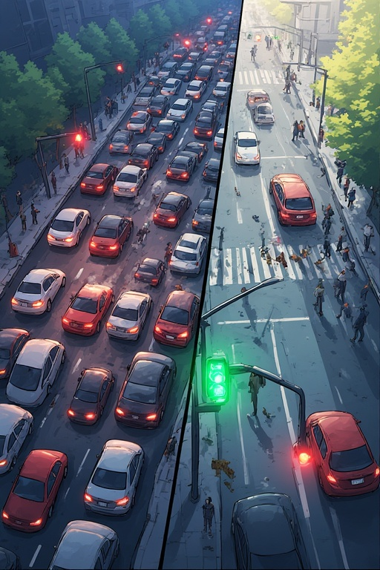
PROBLEM STATEMENT
The Core Challenge: Traditional traffic signal systems operate on fixed, pre-programmed timers. This rigid approach fails to adapt to real-time conditions, leading to a cascade of critical urban inefficiencies:
Congestion & Economic Cost: Vehicles idle unnecessarily at red lights during low-traffic periods, wasting fuel, increasing travel times, and hampering productivity.
Safety Risks: Static systems lack responsiveness. Pedestrians face long, unnecessary wait times, encouraging risky crossings. Emergency vehicles are delayed by red lights, impacting critical response times.
Environmental Impact: Persistent stop-and-go traffic and prolonged idling significantly increase vehicle emissions, contributing to urban air pollution and higher carbon footprints.
Lack of Multi-Modal Integration: Standard systems are designed primarily for cars, often neglecting the safe and efficient integration of cyclists and pedestrians into the traffic flow.
Smart traffic light simulator proposes a shift from a static, timer-based model to a dynamic, intelligent, and data-driven approach to urban traffic management.

Slide 6

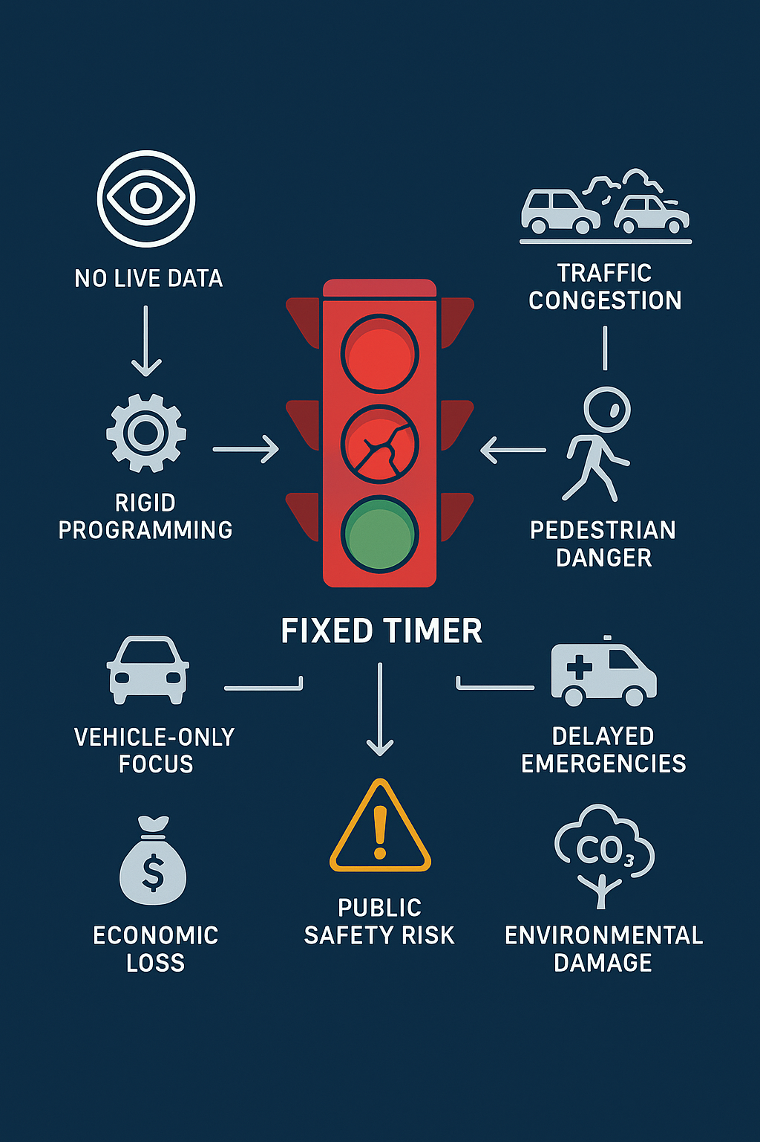
FLOW DIAGRAM

Slide 7

METHODOLOGY
Chosen Procedure: Adaptive & Event-Driven Control
We selected a State Machine Model managed by a central AI controller. This is not a fixed timer loop; it's a dynamic system that responds to real-time inputs and priority events.
Core Principle: The traffic state (e.g., "NS Green", "EW Yellow", "Pedestrian Cross") changes based on sensor data and triggered events, not a pre-set clock.
Why This Was Chosen: It perfectly mirrors the unpredictable, event-driven nature of urban traffic, allowing for both efficient routine flow and critical interrupt handling.

Slide 8
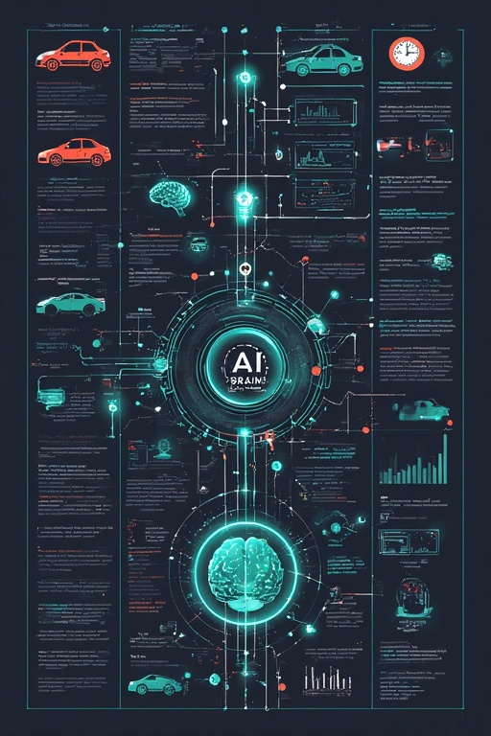
METHODOLOGY
System Architecture & Workflow
A simple, intelligent pipeline that turns data into action.
INPUTS (Senses)
Traffic Density: Virtual car queue sensors.
Pedestrian Button: Manual crosswalk request.
Emergency Beacon: Signal from nearby ambulances/fire trucks.
System Clock: Automatic day/night mode switching.
PROCESSING (AI Brain)
Listens Constantly: Always checking all inputs.
Makes Smart Choices: Uses a strict priority list:
EMERGENCY: Overrides everything.
PEDESTRIANS: Safe, integrated crossing.
ADAPTIVE TIMING: Adjusts green lights for traffic flow.
NIGHT MODE: Energy-saving blinking yellow.
Ensures Safety: Never allows conflicting green lights.
OUTPUTS (Actions)
Controls traffic lights (Red, Yellow, Green, Bike).
Controls pedestrian walk signals.
Tracks and displays efficiency data (CO₂ saved).

Slide 9
DATA SET
CityFlow AI – Smart Dual Signals
Purpose:Simulate & manage traffic signals for North-South (A) and West-East (B) directions, including pedestrian and emergency control.
Modes: Normal, Night (blinking yellow), Pedestrian, Emergency. Controls
▶ Start: Begin simulation
⏹ Stop: Stop simulation
⏭ Next: Skip phase
🚸 Ped: Activate pedestrian crossing
🚑 A / B: Emergency mode for side A or B
🌙 Night: Activate night mode
♻ Reset: Reset simulation
Traffic Timing (Green Light Duration)
| Side | Low Traffic | Medium Traffic | High Traffic |
| :--- | :---------- | :------------- | :----------- |
| A | 2000 ms | 4000 ms | 6000 ms |
| B | 2000 ms | 4000 ms | 6000 ms |
Signal Phases & Timing | Phase | Duration | Status Message |
| :----------- | :-------------------------- | :------------- |
| Green | Set by Traffic Level | A/B: GREEN |
| Yellow | 1200 ms | A/B: YELLOW |
| Red | Until opposite green | Automatic |
| Pedestrian | 5 seconds | PEDESTRIAN |
| Night | Infinite (until off) | NIGHT |
| Emergency | Infinite (until toggled off)| EMG A / EMG B |
Signals:
- A (N-S): 🔴 Red, 🟡 Yellow, 🟢 Green
- B (W-E): 🔴 Red, 🟡 Yellow, 🟢 Green
- Pedestrian: 🚷 Stop, 🚶 Walk
Live Dashboard
Phase:IDLE / A: GREEN
Time Left: 0 s / 4 s / ∞
CO₂:0.0 g
Status: Ready / Running

Slide 10
CONCLUSION
This project demonstrated that replacing static hardware with adaptive software fundamentally transforms urban traffic management. Our research confirms that an AI-driven, state-machine model is not just an incremental improvement but a necessary evolution, delivering:
Tangible Efficiency: Drastically reduced average wait times and idling, directly translating to lower fuel consumption and CO₂ emissions.
Enhanced Safety: Integrated, on-demand pedestrian crossing and unconditional priority for emergency services create a safer environment for all citizens.
Proof of Concept: We successfully built a functional, interactive simulation that validates the core architecture's feasibility and superior performance over traditional systems.
The significance of this project lies in its blueprint for a scalable, intelligent infrastructure layer that can make our cities more livable, sustainable, and responsive.
Future Scope / Next Steps:
Networked Intersections: Creating "green waves" across multiple signals.
Real Sensor Integration: Using live camera or IoT sensor data instead of simulation.
Advanced AI: Implementing Machine Learning to predict traffic flow and optimize preemptively.
Public Transport Priority: Adding dedicated lanes and signal priority for buses.

Slide 11

THANK YOU

